Slide 1
Enhancing text and voice based Chatbot(DBS specific) using Transformers and comparing it with traditional models LSTM
Sandeep Kumar
20049275

Slide 2
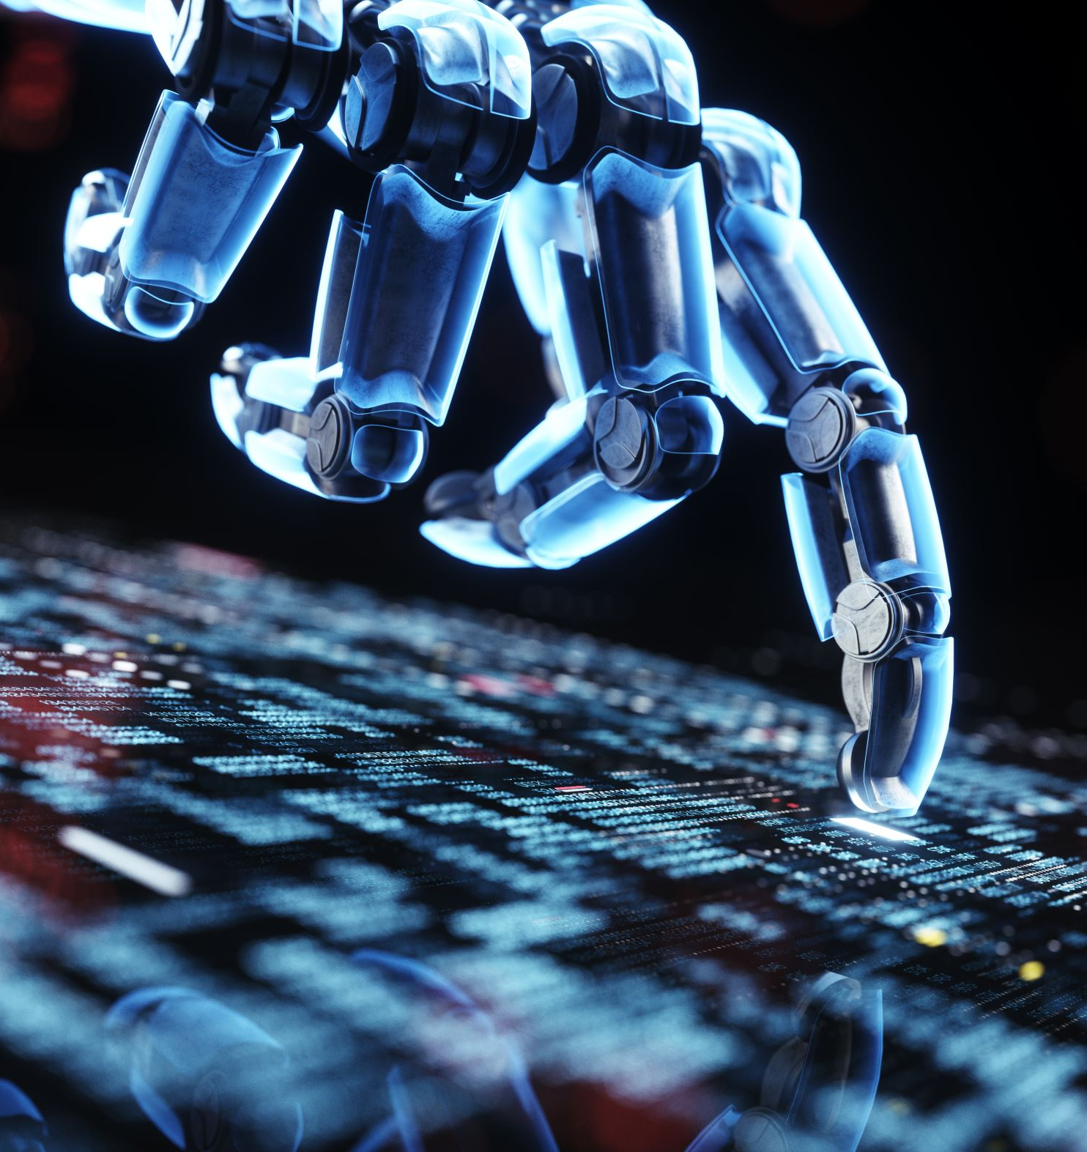
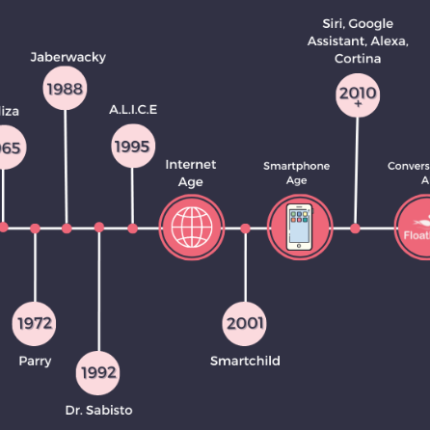
Introduction
What are AI Assistants ?
Automates routine tasks , provide 24/7 support and scalability.
Importance in education ?
Student support, admin tasks, IT helpdesk, faster, context aware response.
How they evolved?
Rule-based → Word Embeddings → RNN/LSTM → Transformers

Slide 3
Research Question
How can transformer-based architecture improve efficiency ("Attention is All You Need" by Vaswani et al. in 2017) and accuracy of a DBS-specific chatbot compared to traditional models like LSTM?

Slide 4
Research Objectives
Design and develop a DBS-specific chatbot using transformer-based and LSTM based models
Compare the chatbot’s performance against traditional models like LSTM

Slide 5
Literature Review
Research Methodology
Saunders, Lewis and Thornhill, 2009
Creswell and Creswell, 2018
Evolution of Conversational AI
Turing, 1950
Weizenbaum, 1966
Neural network & LSTM
Hochreiter & Schmidhuber, 1997
Cho et al., 2014
(NLP) techniques , pipeline
Liu et al., 2015
Elov, Khamroeva, and Xusainova, 2023
Modern Transformers , transfer learning
Vaswani et al., 2017
Behl and Bibhu, 2024
Beyond transformers
Lin & Michailidis, 2024

Slide 6
Research Methodology
Positivist Philosophy
Since the focus of the study is on objective measurement (measurable parameters)rather than subjective interpretation of personal beliefs, emotions(due to limited scope of this study)
Deductive Approach
Existing theories (as explained by Vaswani et al., 2017 transformers-based architecture has higher efficiency than traditional models )are tested through systematic observation and analysis.
Quantitative Method
Focusses exclusively on numerical comparisons and statistical analysis and does not incorporate qualitative methods such as interviews, surveys or subjective analysis because of limited scope of the study
Cross sectional Design
Design is an experimental study as it involves study of change in performance of models in terms of accuracy, speed, etc. Data collection, Performance evaluation takes place at a single point of time.

Slide 7

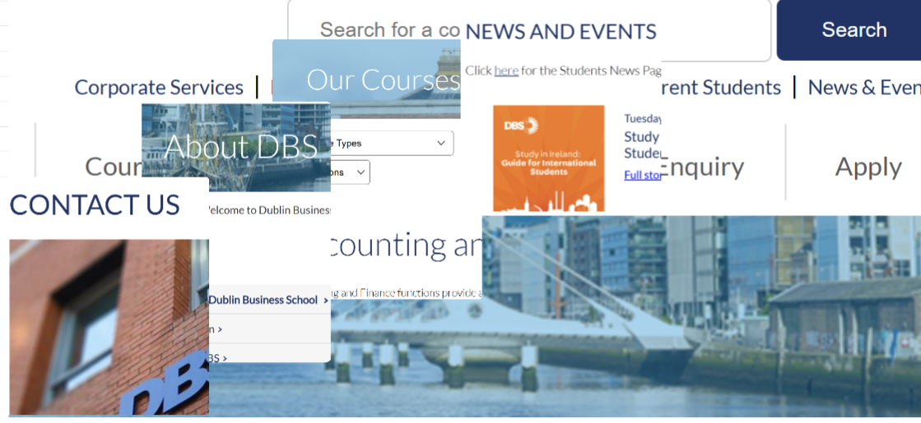
Data Collection - Brochures and Web pages as Dataset

Slide 8
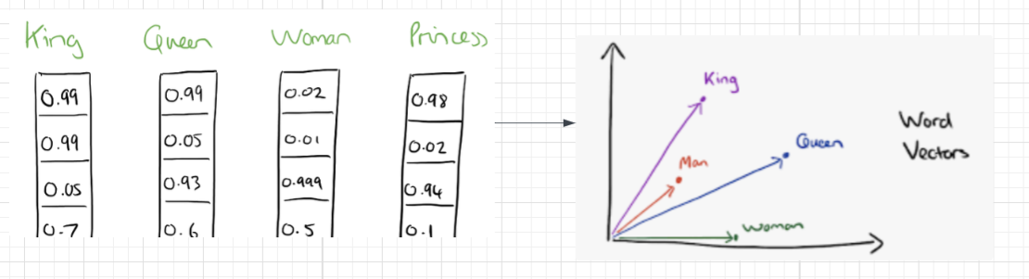
Data preprocessing pipeline
PDF conversion & web content scraping into raw text file.
Text Cleaning and Normalization (whitespace trimming, lowercasing, removal of sensitive information)
Intent Datafile creation(labels, patterns and responses json)
Datafile for testing (Question and Answers pairs)
Tokenization
Breaking text into smaller units (words, sub-words, or sentences) for model processing
Vectorization / Embeddings - process of converting text into numerical vectors that capture semantic meaning

Slide 9
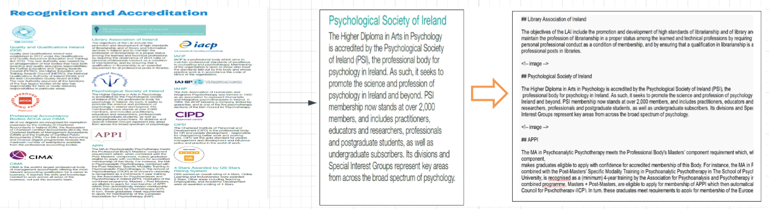
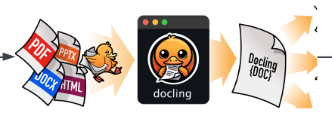
Data Preprocessing cont…
Brochures PDF format into raw text format using DocLing library

Slide 10

Data Preprocessing cont…
Web scraping of DBS Web pages. Result is the text data.

Slide 11
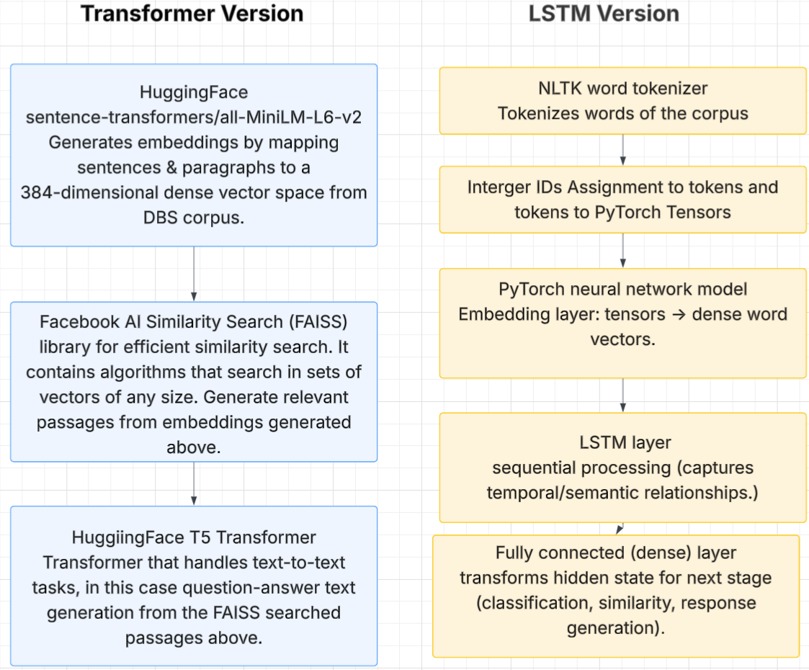
Model Development

Slide 12
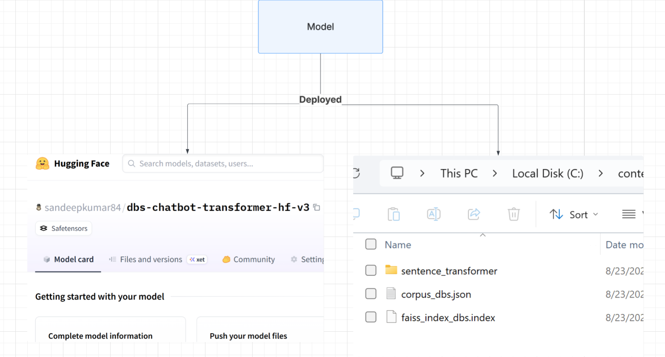
Model Deployment

Slide 13
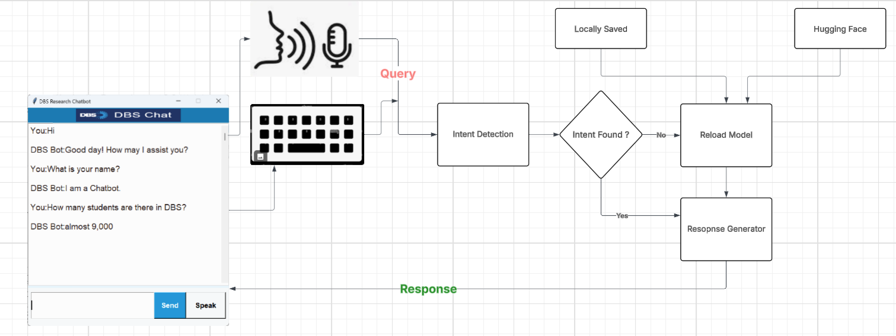
System Design

Slide 14
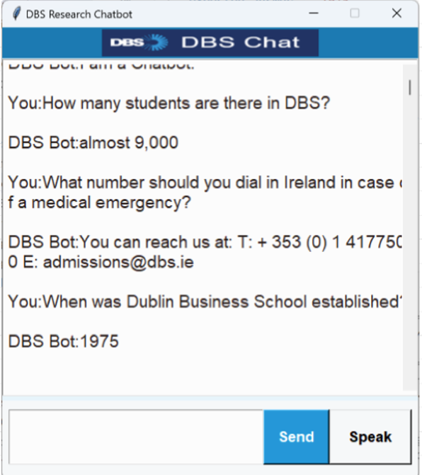
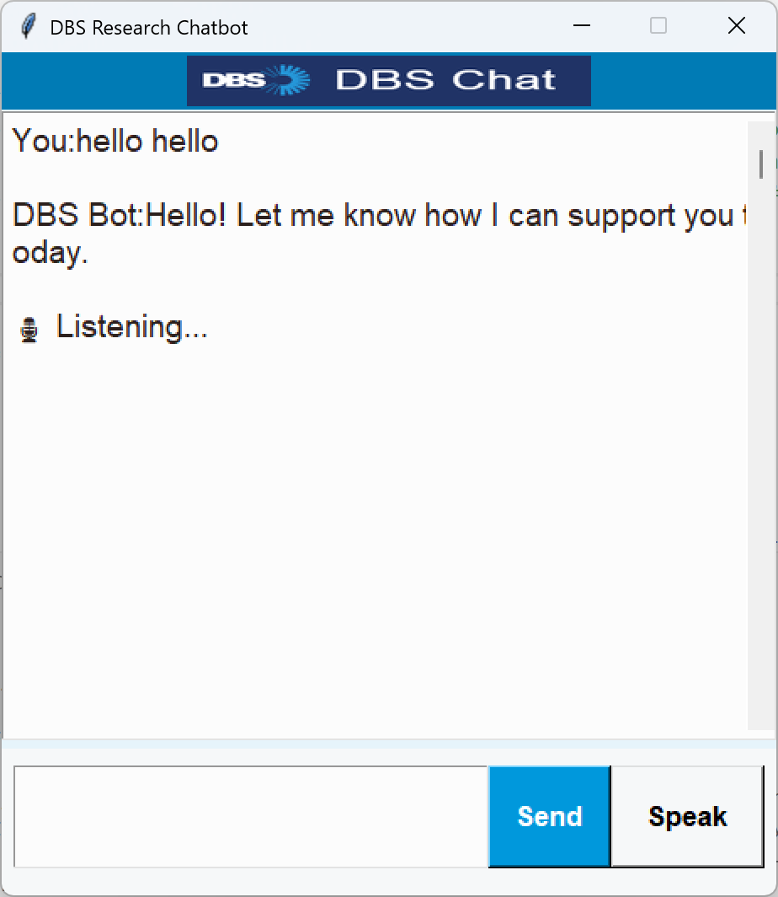
User Interface

Slide 15
Evaluation Metrics
Exact Match Accuracy
Inference Time (Response speed)
BLEU Score (Bilingual Evaluation Understudy n-gram overlap)
BERTScore (Bidirectional Encoder Representations from Transformers → semantic similarity)

Slide 16
Result
Metric | LSTM | Transformer
Exact Match Accuracy | 45% | 84% (+39%)
Average BLEU Score | 21% | 68% (+47%)
Average BERT Score | 87% | 96% (+ 9%)
Average Inference Time | 0.00 Secs | 1.44 Secs (Slower)

Slide 17
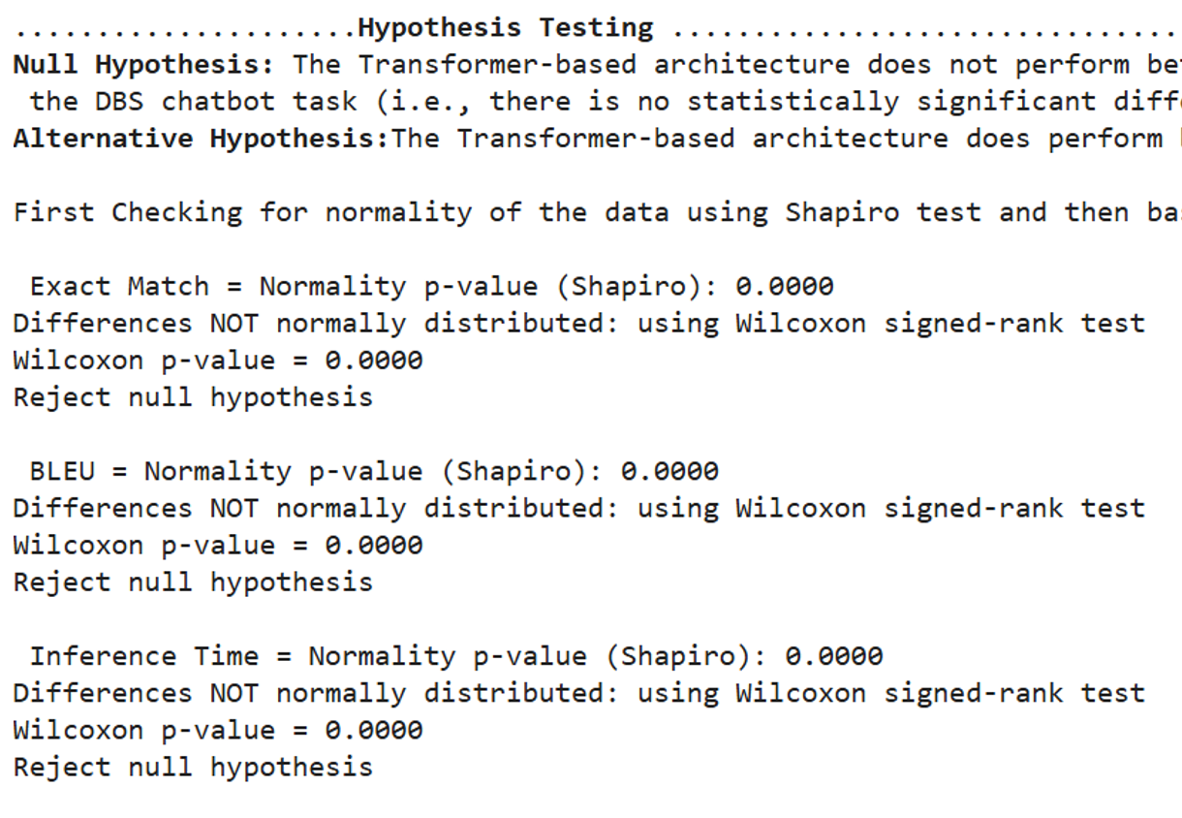
Hypothesis Testing Results
Hypothesis testing to address research question
Null Hypothesis : The Transformer-based architecture does not perform better than the LSTM-based architecture on the DBS chatbot task.
Shapiro–Wilk test confirmed non normality of the data.
Wilcoxon signed-rank test returned a very small p value of 0.001 for all metrics used.
p-value of less than 0.001 supports the rejection of null hypothesis that the two models perform equivalently.
Supports that the transformer-based architecture performed better LSTM in the context of this study.

Slide 18
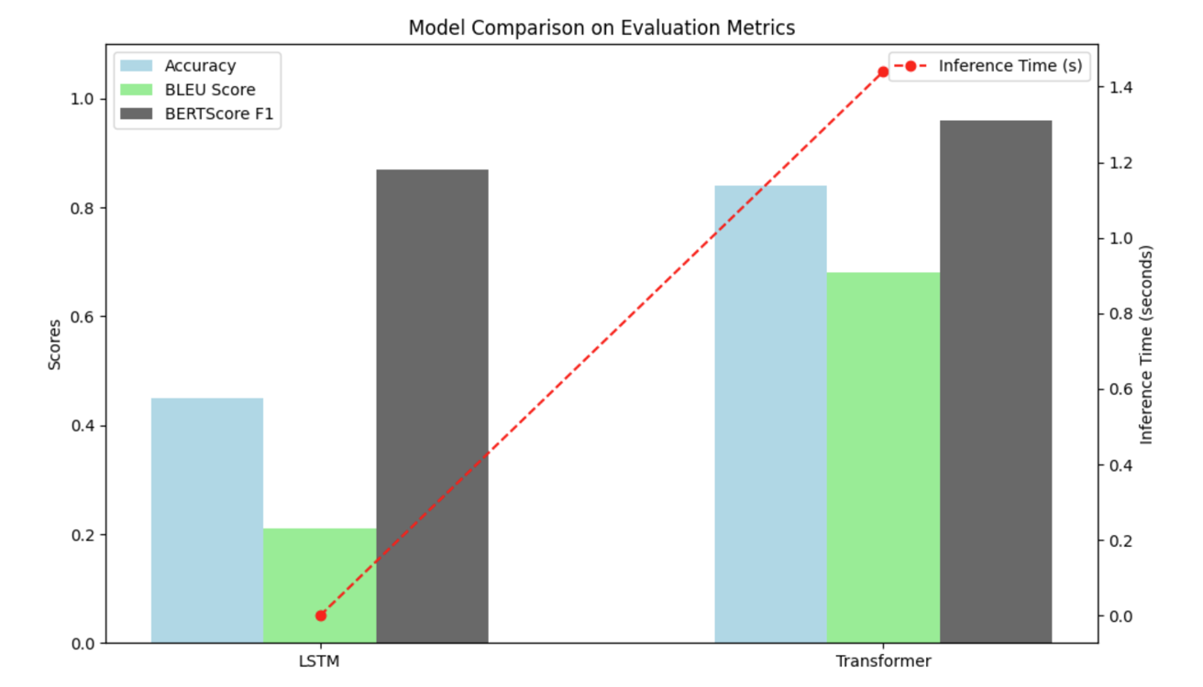
Interpretation
Transformer performed better than LSTM in accuracy & semantic scores for DBS specific corpus.
LSTM faster in inference time
Hypothesis testing results supported the outcome of evaluation.

Slide 19
Conclusion
Transformers: More accurate, better context
LSTM: Lightweight, faster for real-time use
Tradeoff: Performance vs speed
Matches prior theory (Vaswani et al., 2017)

Slide 20
Limitations
Limited dataset (Few DBS-only brochures & web pages content)
No qualitative evaluation (e.g., student satisfaction, usability)
Voice interface not fully tested with diverse accents
Response generated by the system is not full sentences and quite specific. More natural & full responses can be generated using advanced models.

Slide 21
Conclusion & Future Work
Transformer architecture delivered better accuracy, semantic similarity and response quality as compared to LSTM for DBS specific and limited test and trained dataset.
Future Work - Expand dataset across multiple institutions
Incorporate qualitative/user experience feedback
Real time deployment and continues training

